Slide 1
modelling lifestyle changes in Integrated Assessment Models

Slide 2
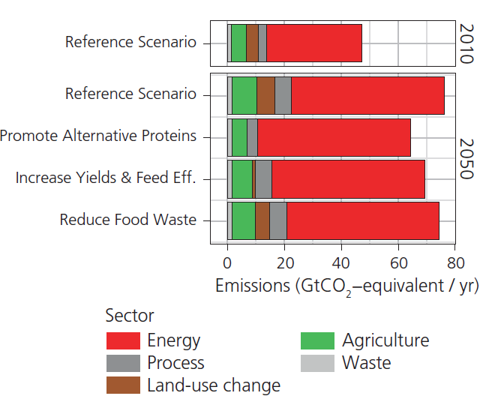
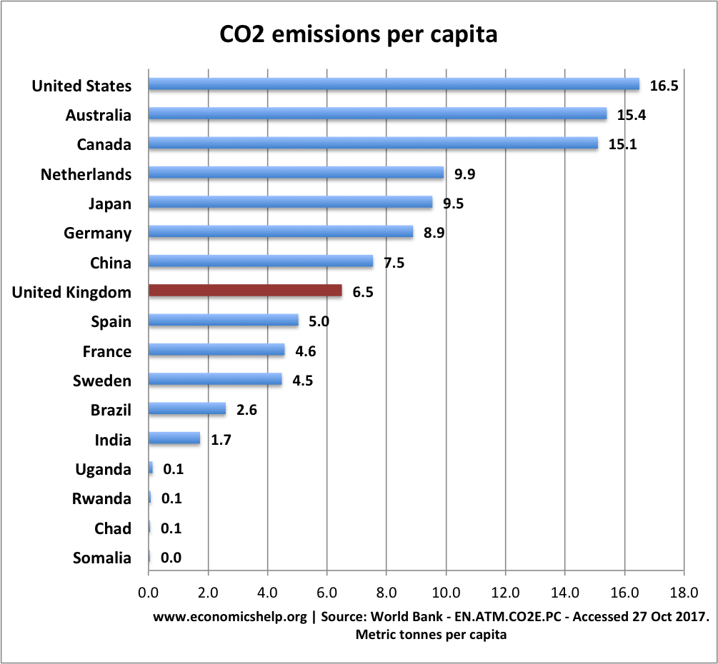
Rationale
Lifestyle changes have proven to be important for meeting ambitious climate targets
Yet… representation in IAMs limited
How can we improve this representation of lifestyles and behaviour in IAMs?
Source: van Vuuren et al. (2016)

Slide 3
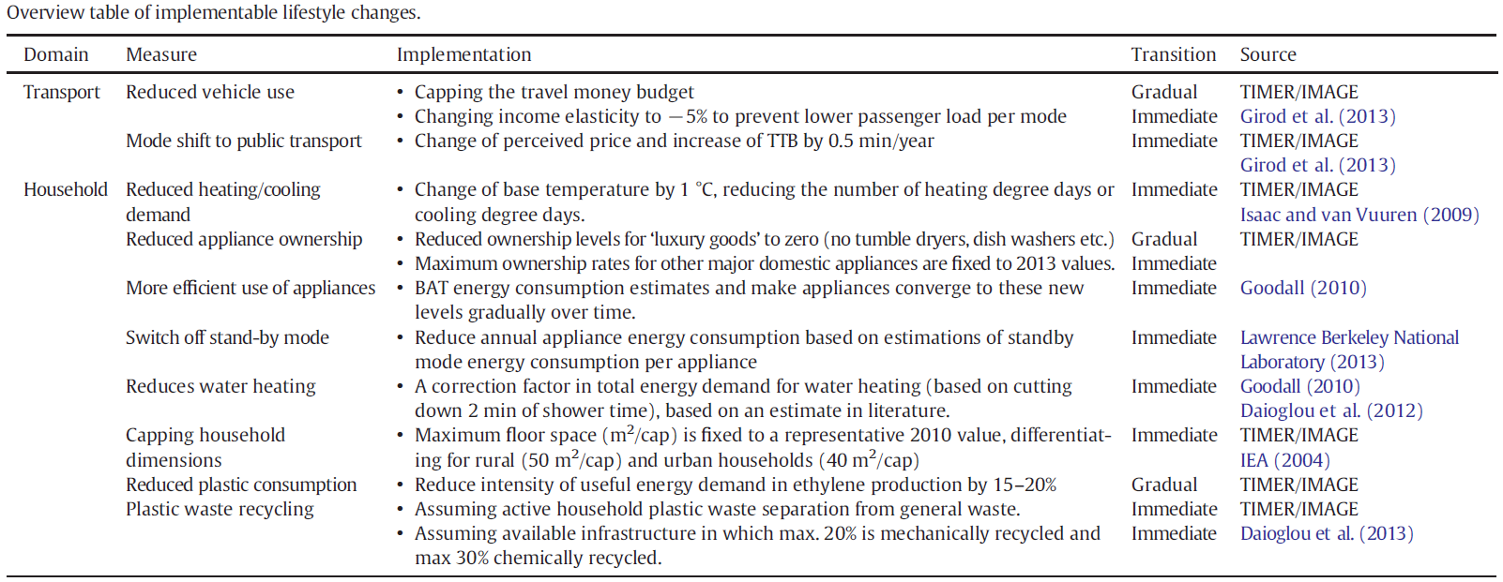
Existing IAM work on lifestyle change
Affectively shows possible impact
SSP1 scenario
Lifestyle studies
Assumptions relatively ad-hoc; generic
Mostly impact-oriented
Not really based on behaviour science literature
Source: van Sluisveld et al. (2016)

Slide 4
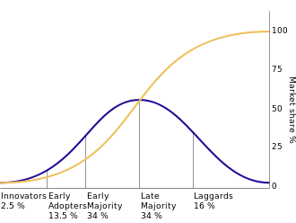
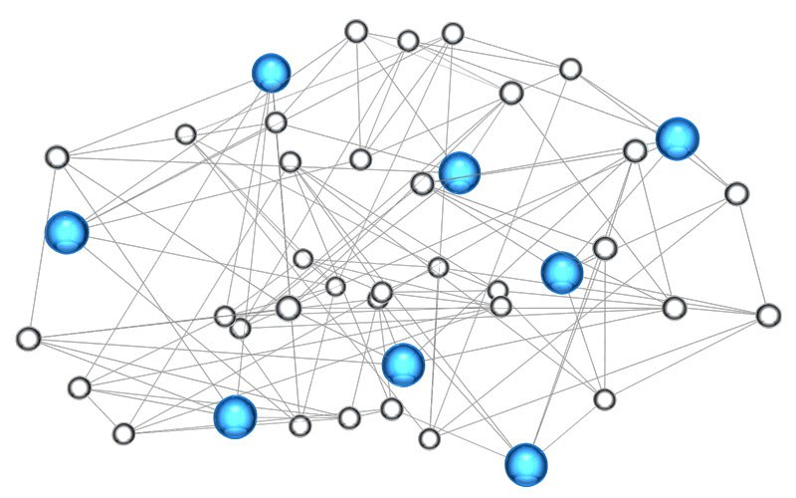
Opportunities to model lifestyle changes
We distinguish 3 possibilities of lifestyle change modelling in IAMs:
can be incorporated into narratives (i.e. more-detailed storylines) or based on exogenous assumptions;
model endogenously with adjustments of parameters and assumptions within the IAMs (e.g. heterogeneity);
by explicitly modelling lifestyle change entirely within the model (e.g. a lifestyles module interacting dynamically).
IAMs

Slide 5
In search of a systematic representation
From behaviour research
Intent-oriented description
Impact-oriented description
Behavioural actions
Motivations
Outcomes

Slide 6
In search of a systematic representation
Impact-oriented description
Sufficiency
Business-as-usual
Improve
Shift
Avoid
Efficiency
E.g. TRANSPORT
Avoid-shift-improve (ASI) framework
Change in vehicle choice
Shift in transport mode
Change in travel distance

Slide 7
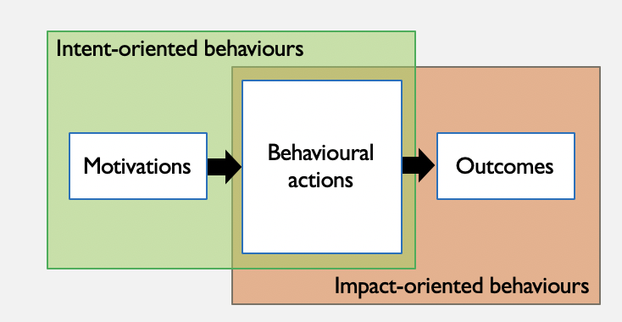
Impact-oriented behaviours from qualitative perspective
Avoid
Shift
Improve
Notes:
This figure gives an overview of the impact-oriented behaviours categorized into common domains, but also where it would fall under the intentions (improve, shift and avoid). Different modelling techniques are distinguished by the different colours. And the blue are the energy models, the dotted lines are exogenously modelled. I will just point out the general trends. The main focus from energy modelling perspective has been on the improve shift, and those that have modelled the avoid categories, have done so exogeously. In the food and consumer goods domain, energy models have explored these in a limited way compared to transport and residential, so there are opportunities here to learn from other models such as input-output analyses and EIO-LCAs. The categories at the top did not fit the commonly-used domains, and had indirect influence on these other domains. Time use shifts and drastic social change movements take a creative approach on modelling the avoid category, and could be interesting to explore endogenously within IAMs as well.

Slide 8
In search of a systematic representation
From behaviour research
Intent-oriented description
Impact-oriented description
Behavioural actions
Motivations
Outcomes
Intent so-far not represented in IAMs

Slide 9
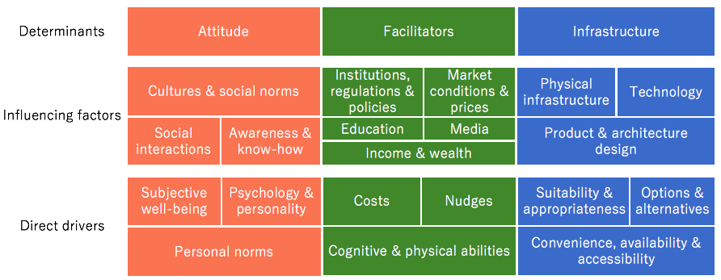
Drivers of intent-oriented behaviours
Intent-oriented description
Attitude
Facilitators
Infrastructure
Source: adapted from Akenji & Chen (2016)
Notes:
From the literature review, we identify these general drivers and influencing factors that affect the behaviours of people, under the categories attitude, facilitators and infrastructure. For example, under attitude, awareness could affect our personal norms to change our behaviours. Under facilitators, institutions, regulations and policies could influence our behaviour through nudges. And under infrastructure, the way products and buildings are designed could influence how convenient and accessible it is for us to adopt a particular behaviour.

Slide 10
Intent-oriented behaviours from quantitative perspective
Better food decisions
Local partnerships
LEGEND
ABM
IO analysis
Energy model
Narrative-backcasting
Promising approaches
Smaller/denser dwelling space
Nudges and bans
Functionality / flexibility in interior design
DIY
Household size
Exogenous
Local travel/ community focus
Urbanity
Digitalise goods
Circular economy
Living in close proximity to peers
Improved awareness
Health/
co-benefits
Vehicle usage intensity
Range anxiety
5 levers of change
Refuelling station availability
Technology adoption attitude
Default-setting & labels
Model availability
Public segmentation model
Risk premium
Availability of EV charger
Partly endogenous
Settlement pattern
Heterogeneity
Social-ecological infrastructural systems framework
Per capita expenditure
Life stage transitions
Nudges and bans
Social learning
Endogenous
Attitude
Facilitators
Infrastructure
Notes:
From the literature, we identified intent-oriented behaviours that were modelled or analysed, and categorized them where they would fit within this attitude, facilitators, infrastructure classification. Furthermore, we placed them on a scale from endogenous modelling to endogenous modelling potential, to get a feel for how likely these aspects could be modelled within IAMs. As you can see, the narrative-based backcasting would be useful to model exogenously, whereas the rest mostly fall under the partly endogenous category, where parameter adjustments can be made to represent these drivers. However, in terms of endogenous modelling of these factors, there is still some uncertainty as to how these drivers would capture these elements, perhaps there is potential for per capita expenditure and life stage transitions, since demographic data and spending behaviours could possibly be integrated into the models to a certain extent. Some promising approaches that have not been modelled have been highlighted in purple.

Slide 11
Recommendations
Harmonize lifestyle change definitions (especially within IAM community)
Expand the range of novel modelling approaches
Expand the range of transformative solutions modelled
Add essential nuanced details to depict lifestyle changes in IAMs
Represent the whole picture, both intent- and impact-perspectives, and not just partial aspects of lifestyle changes
Strategically address trade-offs between exogenous inputs and endogenous modelling
Notes:
From these two perspectives, we have

Slide 12
Modelling detail
Exogenous
Endogenous
Ad-hoc
Informed
Partially
Fully
Stylized adjustments
Narratives or storylines
Consumer segments
Actors react to system
Approaches
e.g. assumed full
vegetarian diet
e.g. narrative
backcasting analysis
e.g. adopter groups
e.g. social learning
Can cover full system
Dynamic modelling of lifestyle changes
Static modelling of lifestyle changes
Limited coverage of system
Less representative of lifestyle changes
More difficult to implement in IAMs
Easier to implement in IAMs
More representative of lifestyle changes
Notes:
- An interesting observation from this literature analysis is the trade-offs found between using exogenous inputs and endogenous modelling within IAMs
Yellow - Coverage of system and ease of implementation
Blue - Dynamics of modelling and representative of changes
Range from exogenous to endogenous
On the exogenous side:
- Approaches such as stylized adjustments are ad-hoc modelling techniques
More informed modelling detail can be approached through better narratives or storylines
On the endogenous side:
Partially application can be done through improved consumer segmentation such as the adopter groups that partially responds to other aspects within the model.
Fully endogenous modelling can be achieved where actors are fully reacting and sending feedback to the rest of the model.

